Slide 1



ME 5545 - Fundamentals of Battery Storage Systems for Electric and Hybrid Vehicles Final Project
Suryakiran M. George
School of Engineering and Computer Science
Electrical and Computer Engineering Dept.

Slide 2

Life Cycle Assessment of Carbon Footprint of an EV battery
Notes:
EVs do not produce direct tailpipe emissions from burning diesel and gasoline.
But battery-powered EVs have a major emissions challenge of their own: production of the batteries themselves is a highly carbon-intensive process.

Slide 3
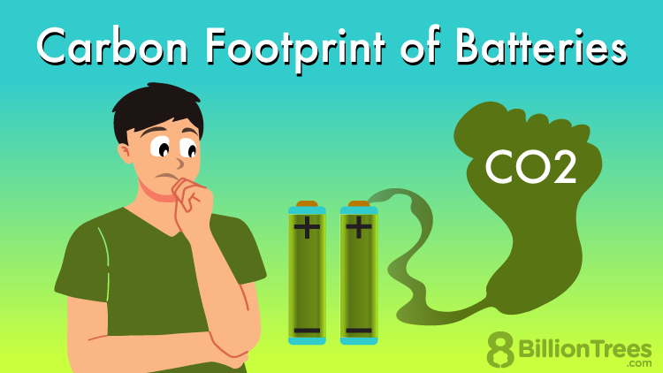
Motivation
Race Towards Decarbonization
Assess Environmental Impact -- To Quantify the environmental impact of throughout their lifecycle.
Regulatory compliance -- EU Battery Regulation mandates declaration of CO2 footprint of batteries (from 2025)
Industry competitiveness -- Low-carbon battery production is a competitive advantage for OEMs.
Sustainability goals -- Aligns with broader objectives to reduce greenhouse gas emissions
Consumer transparency -- Helps consumers make environmentally conscious choices
Market Differentiation -- Carbon footprint classes and thresholds will be used to differentiate batteries
Improvement Identification -- Helps identify areas for reducing emissions in the battery production chain
Policy Support -- Informs policymakers in developing strategies for a low-carbon battery industry

Slide 4
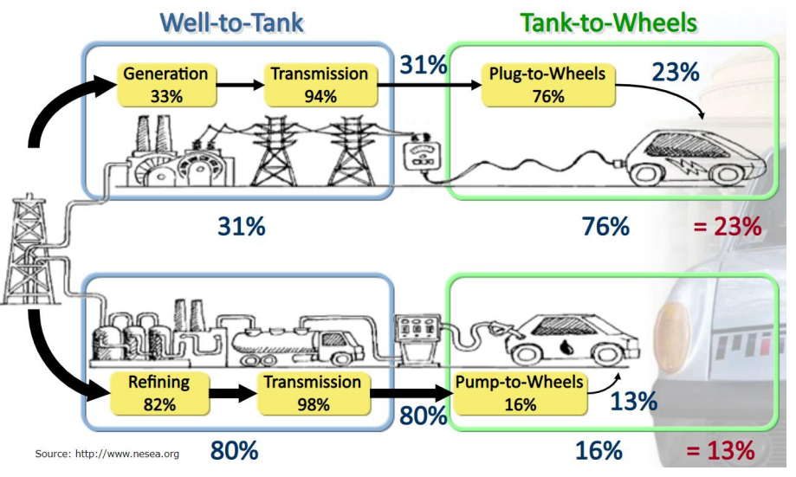
Life Cycle Assessment
EVs have higher WTW efficiency compared to ICEVs. It can be significantly higher if we use renewable electricity( wind, solar etc.)
Well to Wheel Efficiency

Slide 5
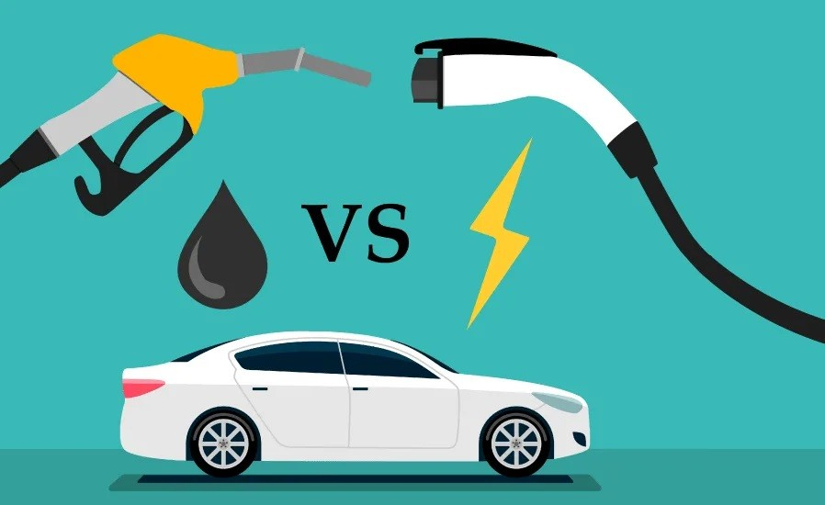
Life Cycle Assessment
Cradle to Grave approach
High CO2 impact during battery construction phase (up to 2X the CO2e of an equivalent ICE vehicle during the manufacturing phase)
Green electricity charging can reduce overall impact significantly
Life Cycle Emissions: Approx. 40 tons CO2e by EOL vs 70 tons of CO2e for ICE car.
EVs do have a higher initial carbon footprint due to battery production, but they significantly outperform ICEVs in terms of lifetime emissions, especially when charged with green electricity.
Ref: https://climate.mit.edu/ask-mit/are-electric-vehicles-definitely-better-climate-gas-powered-cars

Slide 6
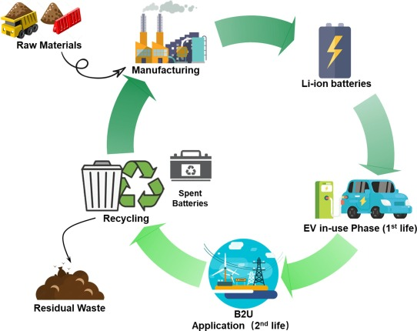
Life Cycle Assessment
Cradle to Grave approach
Material Extraction (usage per kWh)
Lithium = 50 kg/kWh
Cobalt = 5 kg/kWh
Nickel = 30 kg/kWh
Graphite = 20 kg/kWh
Li-ion battery Manufacturing
Energy Consumption = 150KWh/KWh
CO2 emissions = 200 kg/kWh
Use phase (1st & 2nd Life)
End of Life (Recycle)
Total GWP(Global Warming potential) per kWh = GWP from raw material extraction + GWP from battery manufacturing = 1550 kg CO2/KWh
GWP factor = 10kg CO2 /kg
Ref: https://apaengineering.com/compliance-blog/lca-reveals-ev-battery-environmental-impact
Data Sources: Hypothetical data for illustrative purposes

Slide 7
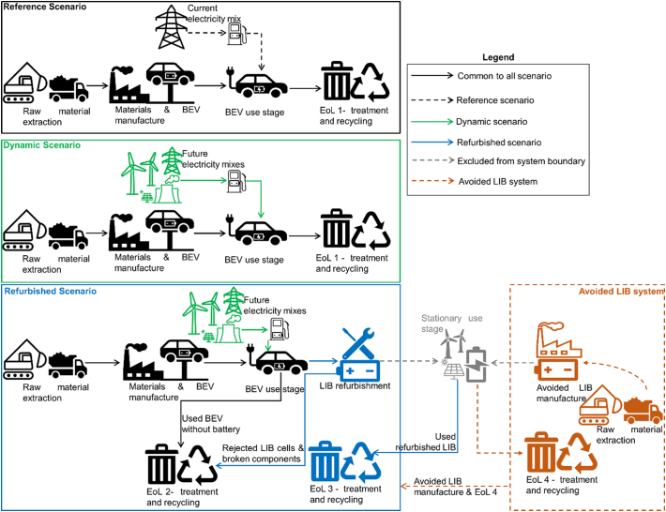
Life Cycle Assessment
Scenarios – Avoided Burden Approach
System boundary of the LCA includes the 2nd Life (E.g., residential energy storage application (e.g., powering homes, storing solar energy, etc.))
Refurbished BEV battery in 2nd Life would displace the need for a new LIB
2nd Life battery in the stationary application → avoids environmental impact of producing a new battery.
Avoided Impacts → Credited to the BEV’s lifecycle; reducing the overall environmental footprint of the BEV.
Encourages recycling, repurposing, and second-life applications of used batteries, thereby promoting a circular economy and reducing the need for new resource extraction.
Reference: Article on NCBI

Slide 8
Life Cycle Assessment
PCF Calculation – Steps
End Goals :
Calculation of PCF during manufacturing/assembly of Battery (consider transport of materials/cells/packs)
Manufacturing/Assembly → Material extraction, cell production, transport, assembly → ~270 kg CO2 per kWh (typical estimate)
Calculation of the PCF during 1st Life (past operations, prediction of PCF till 1st Life EOL as defined by OEM (e.g., 120K km 8 years 70%))
1st Life (Operational) → Energy consumption, grid carbon intensity, vehicle efficiency → ~7,200 kg CO2 over 120,000 km or 8 years
Estimation of the PCF during 2nd life after EOL in the vehicle (Top 3 use cases)
2nd Life (Repurposing) → Avoided emissions (new battery production), stationary use → Avoided emissions: ~200 kg CO2 per kWh
Estimation of PCF during recycling based on the recycling method & battery chemistry
Recycling → Recycling method, recovery rate, battery chemistry → ~10-30 kg CO2 per kWh (depending on method)

Slide 9
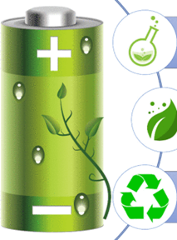
PCF Calculator for EV battery in Operation – 1st Life

Slide 10
PCF Calculator for EV battery in Operation
EV Battery in Operation – Factors/Inputs
Energy mix of the charging source and it’s respective emission factor
https://app.electricitymaps.com/map
Peak Hours or Off-Peak Hours
KWh/mile in EV ←→ MPG in ICE
Depends on vehicle efficiency
Depends on driving characteristics
Depends on Accessory load
Depends on ambient conditions
CO2 (gms/Tons) =
KWH/mile * Distance (miles) * CO2 factor per KWH * Peak factor Constant
CO2 (gms/Tons) wrt to battery =
KWH * CO2 factor per KWH * Peak factor Constant * Eff. of charging

Slide 11
PCF Calculation
Energy Calculation
Given Instantaneous V & I at the battery (remove outlier cases)
In a single-phase DC circuit, the formula for instantaneous Energy:
E = V * I * dt
where:
E : Instantaneous energy (KWHs)
V : Voltage (Volts)
I : Current (Amps)
dt : Small-time interval (secs/Hours)
Total Energy : E_total = ∫(V * I * dt)

Slide 12
PCF Calculation
EV Battery in Operation –Predictions till EOL
Remaining Days to EOL
Days to EOL = [120k Km, 8 years, 70% Capacity Fade]
Minimum of :
Days remaining to 120k Km
Days remaining to 8years
Days remaining to 70% Capacity Fade

Slide 13
PCF Calculation Algorithm
Initial Processing – Clean Up & Recover useful data
Drop any rows with NaN values
Consolidate all Charging Events – Charge Begin & Charge End
Look for any Charge Sequence mismatches to reject the data.
Look for sampling time gaps to truncate any outliers & indicate data loss
Reject data with V>1000 or I>1000
Calculate Net energy at the Battery (must be around 0)

Slide 14
PCF Calculation Algorithm
Calculate KWh Consumed So far
Assumption: Given is the data from the time it was put into operation.
Calculate the KWh Consumed
= Sum of Instantaneous Energy During Charging Events
Calculate total no of days so far
= (End Date – Start Date)
Calculate the KWh per day
= KWH Consumed / Total # of Days

Slide 15
PCF Calculation Algorithm
Estimate Future KWh Consumption till EOL
Assumption: EOL = 8 years, 120K km, 70%SOC
Calculate the Remaining Days to 120K Km
Average kms/day = (Final – Initial) odometer / Total # of Days
Days to 120K km = Remaining Kms to 120K / (Avg Kms/day)
Calculate the Remaining Days to 8 years
Days to 8 years = (Date at 8 years – Current Date).Days
Calculate the Remaining Days to 70% SOC
Look up table data from Manufacturer/Real time data from BitC
Calculate the Remaining Days to EOL
Days to EOL = min (Days to 120K, Days to 8yrs, Days to 70%SOC)

Slide 16
PCF Calculation Algorithm
Total KWh & CO2 Emissions in 1st Life of EV Battery
Assumption: Average CO2 Emissions factor is used for estimation in absence of real time data
Calculate the Future KWH till EOL
= (Days to EOL x KWh per Day)
Calculate KWh for the 1st Life of EV Battery
= (KWh Consumed + Future KWH till EOL)
Calculate the CO2 Emissions for the 1st Life of EV Battery
= KWh for the 1st Life x Avg CO2 Factor per KWh(~0.39kg)
Ref: https://www.eia.gov/tools/faqs/faq.php?id=74&t=11

Slide 17
PCF Calculation Algorithm
Total KWh & CO2 Emissions in 1st Life of EV Battery wrt to Charger
Assumption: Average Charging Efficiency = 97%
We have CO2 Emissions for the 1st Life of EV Battery wrt Battery
= KWh for the 1st Life X Avg CO2 Factor per KWh(~0.39kg)
Calculate CO2 Emissions for the 1st Life of EV Battery wrt Charger
= KWh for the 1st Life X Eff_Factor(100/97) X Avg CO2 Factor per KWh(~0.39kg)

Slide 18
PCF Calculation Algorithm
Areas of Improvement
The available data is discontinuous (calculation will not be accurate)
CO2 factor per charging event → More accurate results
Need SOH to estimate SOC degradation (else need lookup table for each vehicle type)
Charging efficiency is assumed as 97%; this may vary depending on the type of charging (DC/AC (Lvl1 or 2)) which is unavailable.
Data unavailable for 2nd Life, Recycling & Manufacturing to make accurate estimations

Slide 19
PCF Calculator for EV battery in Manufacturing & Integration

Slide 20
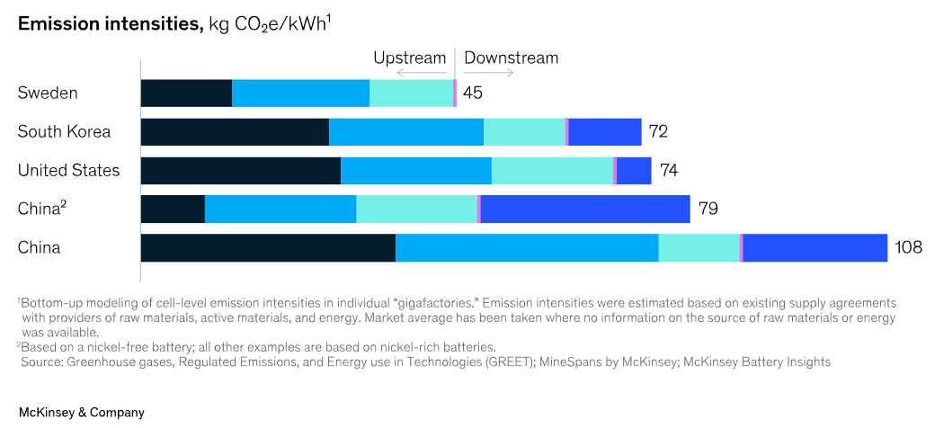
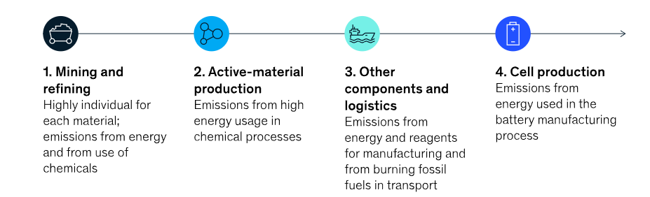
PCF Calculation Algorithm - Manufacturing
Key Factors
Emissions in the battery value chain are primarily driven by production location, sources of raw materials & energy.
China dominates the market : > 70% market share & has the most emission-intensive production processes.
Low-carbon battery production will become a competitive advantage.

Slide 21
PCF Calculation Algorithm
Manufacturing & Integration
Example Data (for estimation):
Raw Material Extraction:
Lithium: 30 kg
Cobalt: 5 kg
Nickel: 25 kg
Graphite: 60 kg
Emission factors (kg CO₂e per kg of material):
Lithium: 15 kg CO₂e/kg
Cobalt: 20 kg CO₂e/kg
Nickel: 18 kg CO₂e/kg
Graphite: 10 kg CO₂e/kg
Battery Cell Manufacturing:
Energy consumption: 0.5 kWh per kWh of battery capacity
Emission factor for electricity (assuming grid mix): 0.4 kg CO₂e/kWh
Battery Pack Assembly:
Energy consumption: 0.1 kWh per kWh of battery capacity
Emission factor for electricity: 0.4 kg CO₂e/kWh
Transportation:
Distance traveled (raw materials to factory): 500 km
Distance traveled (finished battery pack to EV manufacturer): 200 km
Transport type: Freight truck (diesel)
Emission factor for diesel truck: 0.1 kg CO₂e per ton-km
Battery Integration into EV:
Energy consumption: 0.05 kWh per kWh of battery capacity
Emission factor for electricity: 0.4 kg CO₂e/kWh
PCF total​ = PCF raw materials​ + PCF cell manufacturing​ + PCF pack assembly​ + PCF raw materials transport​ + PCF pack transport​ +PCF EV integration​
PCF total = 1600+12+2.4+25+7.2+1.2 = 1647.8 kg CO₂e

Slide 22
PCF Calculator for EV battery in 2nd Life

Slide 23
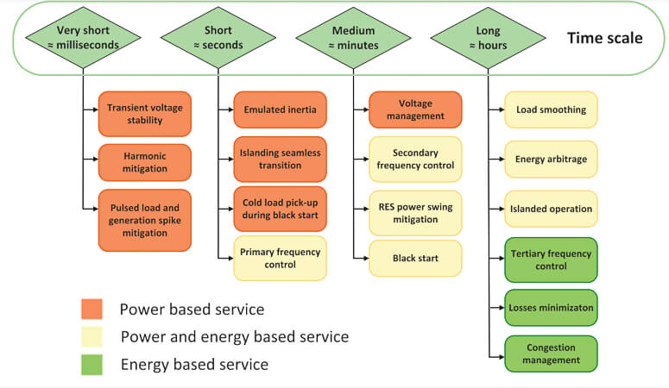
PCF Calculation Algorithm – 2nd Life
Key Factors
Battery Energy Storage Systems (BESS) act as reserve energy that can complement the existing grid.
Power OR Energy-intensive
Deployment time scale - (ranges from millisecs to hours)
An overview of the different ancillary services provided by BESS. Image used courtesy of IEEE Open Journal of the Industrial Electronics Society

Slide 24
PCF Calculator for EV battery in Recycling

Slide 25
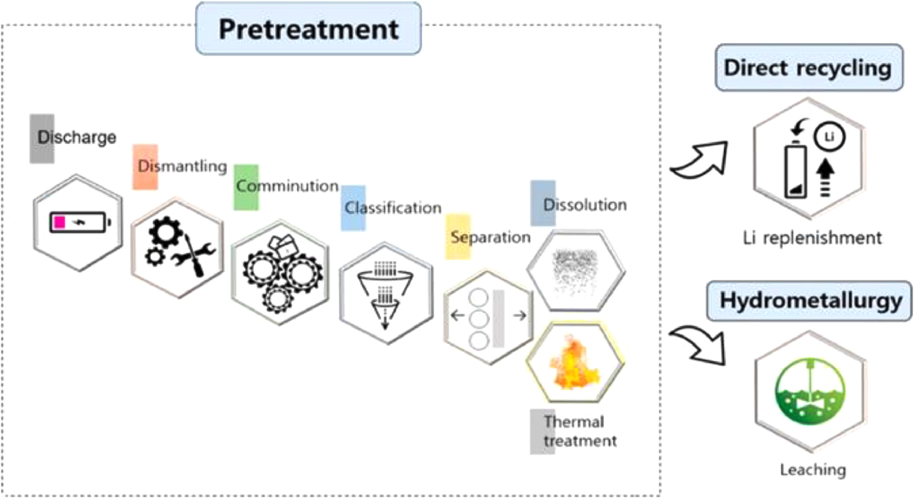
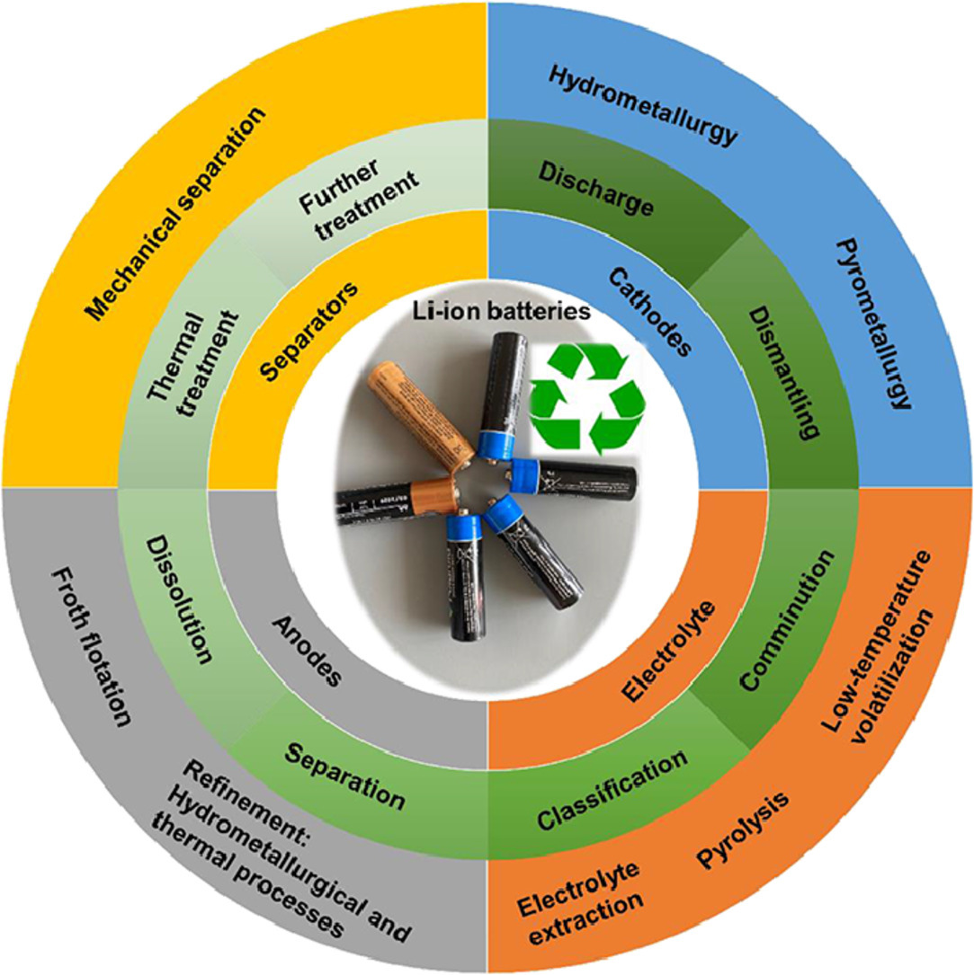
PCF Calculation Algorithm – Recycling
Key Factors
Reduction of environmental impact by reducing CO2 emissions – Saves natural resources to reduce raw materials mining.
The most common cathode recovering methods are a combination of pyrometallurgical and hydrometallurgical methods.

Slide 26
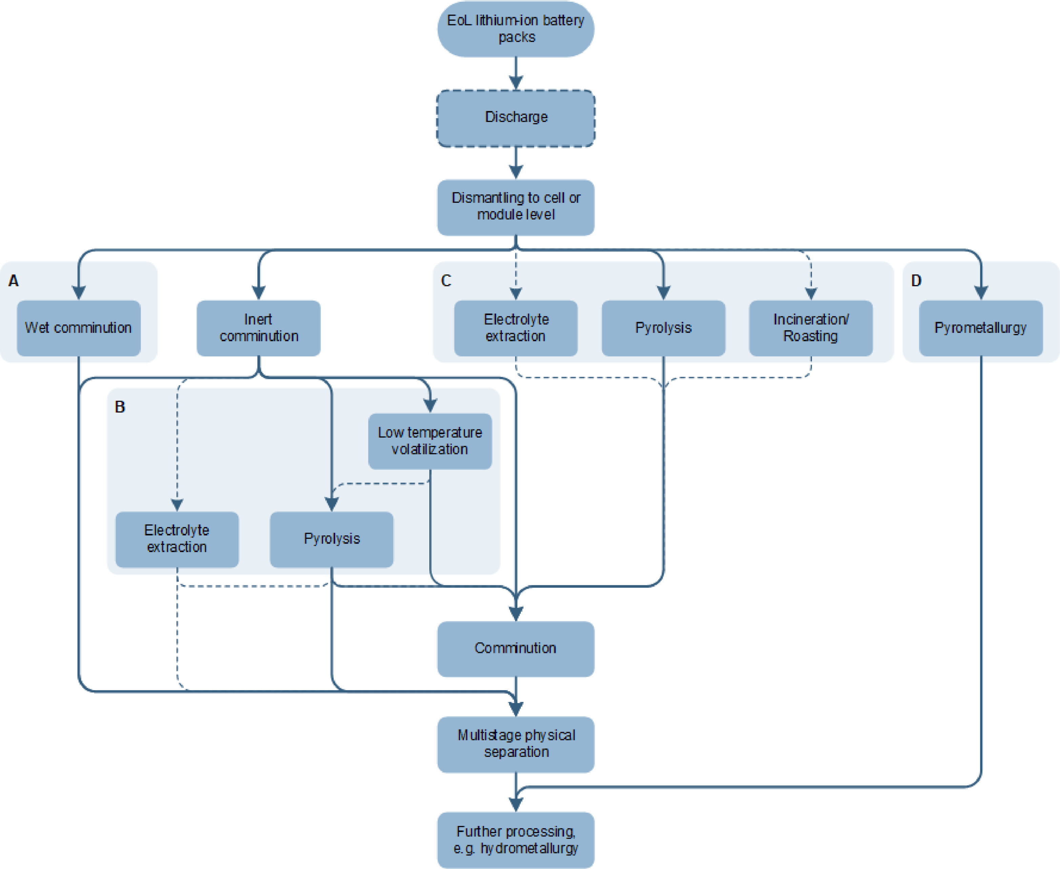
PCF Calculation Algorithm – Recycling
Key Factors
LIB recycling processes with a focus on electrolyte recycling.
Process steps that incorporate electrolyte recovery and/or removal are highlighted:
A - Mechanical processing including wet comminution
B - Mechanical processing and thermal treatment
C - Thermal pre-treatment methods followed by mechanical processing
D - Pyrometallurgical processing.

Slide 27
Conclusion
The calculated CO2 Emissions of EV battery in 1st Life is found to be approx. xxxxxx
With the avoided burden approach; the overall CO2 Emissions for the EV battery through it’s Life Cycle is significantly lower than ICE Vehicles.
Even when considering the higher emissions from the manufacturing phase (due to the battery), the long-term operational savings from cleaner energy use outweigh the initial carbon burden.
EVs can potentially be Carbon-neutral or even Carbon-Negative over their lifetime if the energy grid becomes cleaner and if innovations in battery manufacturing (such as increased efficiency and reduced use of rare materials) continue.

Slide 28
DEMO
Thanks, Questions?

Slide 29
References
https://www.mckinsey.com/industries/automotive-and-assembly/our-insights/the-race-to-decarbonize-electric-vehicle-batteries
https://www.sciencedirect.com/science/article/pii/S2772656822000458
https://eepower.com/technical-articles/applications-of-grid-connected-battery-energy-storage-systems/#
https://pmc.ncbi.nlm.nih.gov/articles/PMC9171403/
https://thebatterypass.eu/
https://www.aeva.asn.au/files/224/
https://ev-database.org/car/1991/Tesla-Model-3
https://apaengineering.com/compliance-blog/lca-reveals-ev-battery-environmental-impact Data Sources: Hypothetical data for illustrative purposes
https://www.transportationenergy.org/resources/the-commute/life-cycle-carbon-emissions-of-electric-and-combus
https://eplca.jrc.ec.europa.eu/GRB-CBF_CarbonFootprintRules-EV.pdf

Slide 30
Notes
Charging Eff. between level 1, 2 ,3 ()
Calculate eff. of Vehicle - KWh/mile based on V, I, Dist
Compare with ICE values
Model based on V, I, time and not SOC
2% loss in capacity in every 10,000km (check online)

Slide 31
Too much Supercharging is bad for battery chemistry?
Battery Degradation
Fast Charging and Degradation:
Fast charging can lead to faster battery degradation, which reduces the value and efficiency of electric vehicle (EV) batteries over time. This degradation is often due to two main forms: capacity fade and power fade.
Capacity fade involves a decrease in the amount of energy a battery can store, often due to the loss of lithium ions through waste reactions.
Power fade refers to a reduction in the rate at which energy is provided, typically caused by metallic lithium plating that blocks ion flow.
Physical and Chemical Impacts:
Charging a battery involves both physical and chemical processes. High voltage charging can cause small cracks or damage to the battery material, leading to increased heat generation and accelerated degradation.
Laboratory studies have shown that high voltage and heat are significant factors in battery cell degradation. However, these effects are mitigated in full battery packs by sophisticated management systems that regulate temperature and voltage.
Battery Chemistry
Different Chemistries:
Different battery chemistries respond differently to charging practices. For instance, Lithium Iron Phosphate (LFP) batteries can be charged to 100% regularly without significant degradation, whereas Nickel Manganese Cobalt (NMC) batteries may require more careful charging practices.
The choice between LFP and NMC batteries often depends on factors such as cost, thermal stability, and performance in different conditions.

